Slide 1
HTML
Tables
COMP 2511 - Web I: Client Development
Randy Connolly
Modified by Yasaman Amannejad & PJ Perri
Department of Mathematics and Computing,
Mount Royal University

Slide 2

Objectives
Textbook: Fundamentals of Web Development
  Chapters 5
By the end of this part of the course, you will
  What HTML tables are and how to create them
  Very introductory styles used to change the appearance of tables

Slide 3
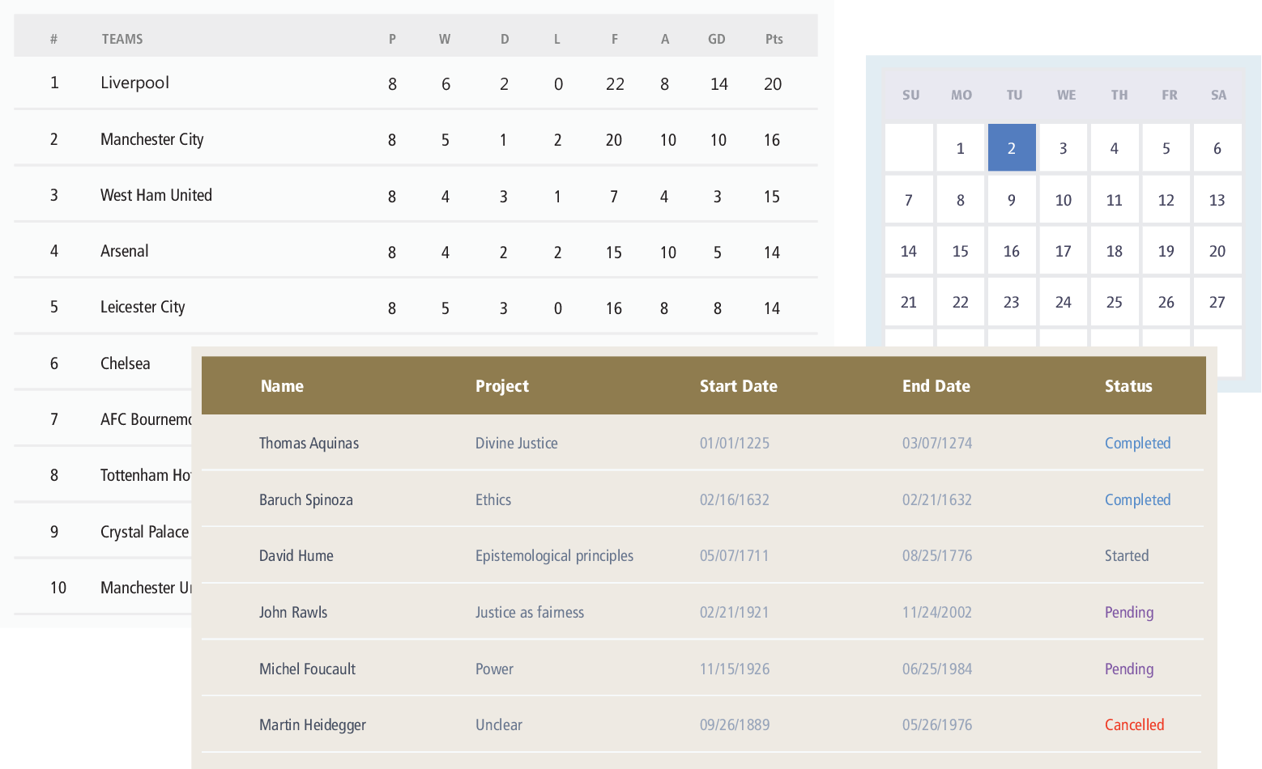
HTML Tables
A table in HTML is created using the <table> element and can be used to represent information that exists in a two-dimensional grid.
Just like a real-world table, an HTML table can contain any type of data: not just numbers, but text, images, forms, even other tables
<table> contains any number of rows (<tr>); each row contains any number of table data cells (<td>)

Slide 4
Table Elements
tr Element
  Defines individual table rows
td Element
  Contains table data elements – aka columns
th Element
  Defines a heading cell

Slide 5
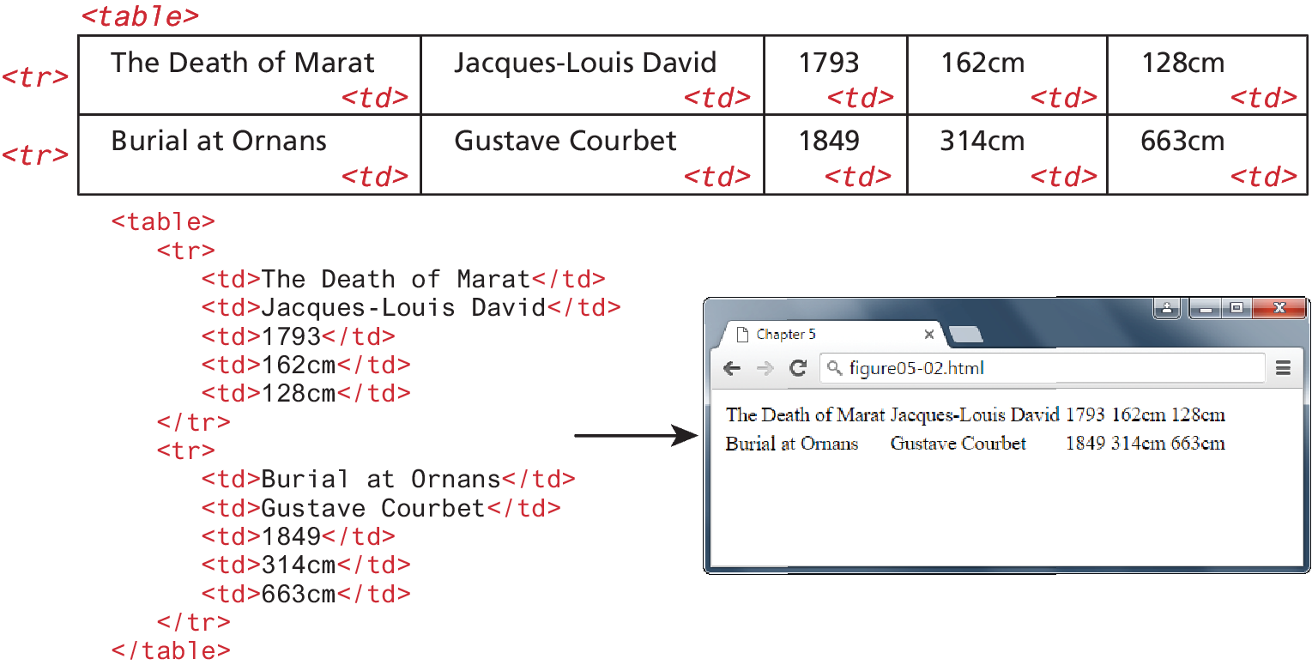
Basic table structure

Slide 6
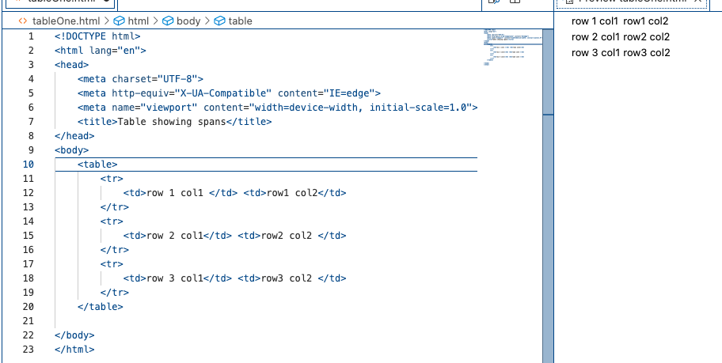
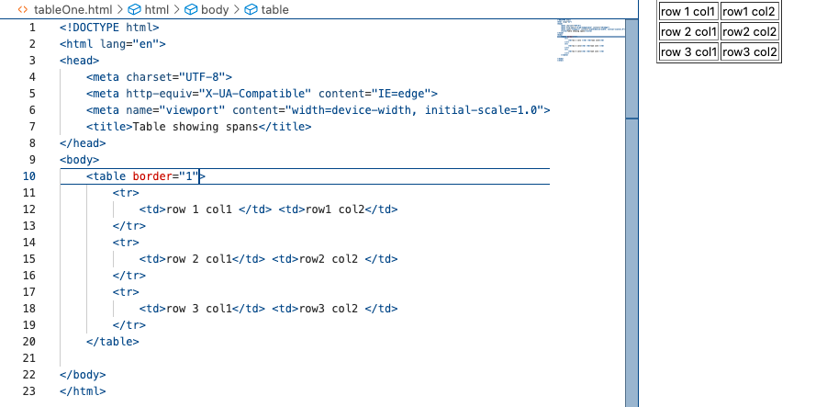
Border attribute Inline style

Slide 7
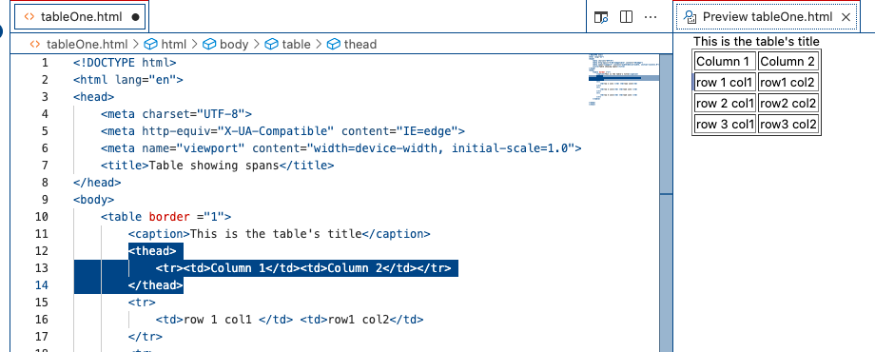
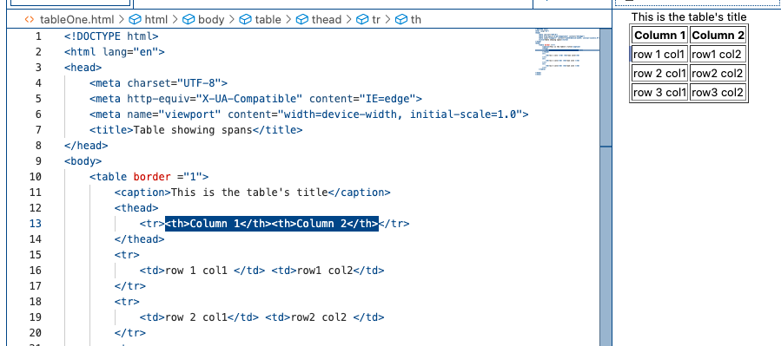

Slide 8
Table attributes summary
Summarizes the table’s contents for speech devices to make the table more accessible to users with visual impairments.
  <table summary="Monthly savings for the Franks family">

Slide 9
Semantic Elements for tables
caption
thead
tbody
tfoot
A table can be split into three SEMANTIC sections:
  Head (thead element)
    Table titles
    Column headers
  Body (tbody element)
    Primary table data
  Table Foot (tfoot element)
    Calculation results
    Footnotes
  and…
  Caption element – table’s title
    must be placed immediately after table tag
Semantic elements don’t change the appearance of the content – UNTIL styles are added

Slide 10
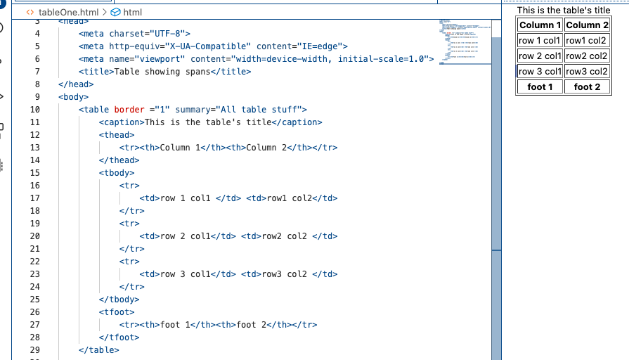

Slide 11
Spanning Rows and Columns
All content must appear within the <td> or <th> (table headings) container.
Each row must have the same number of <td> or <th> containers.
If you want a given cell to cover several columns or rows, then you can do so by using the colspan or rowspan attributes
    The values of these attributes specify the number of rows or columns merged into one cell.
    Can be placed inside any table data or table heading cell.

Slide 12
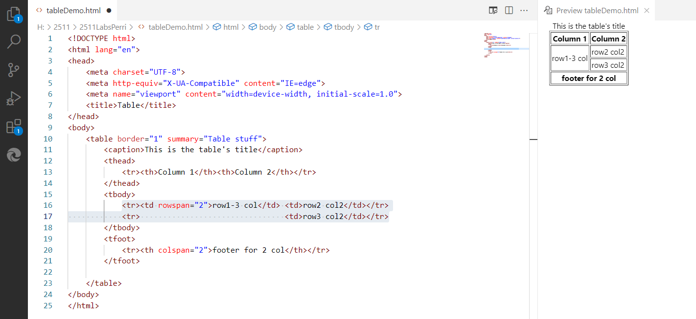
white space does NOT matter,
but may make layout clearer

Slide 13
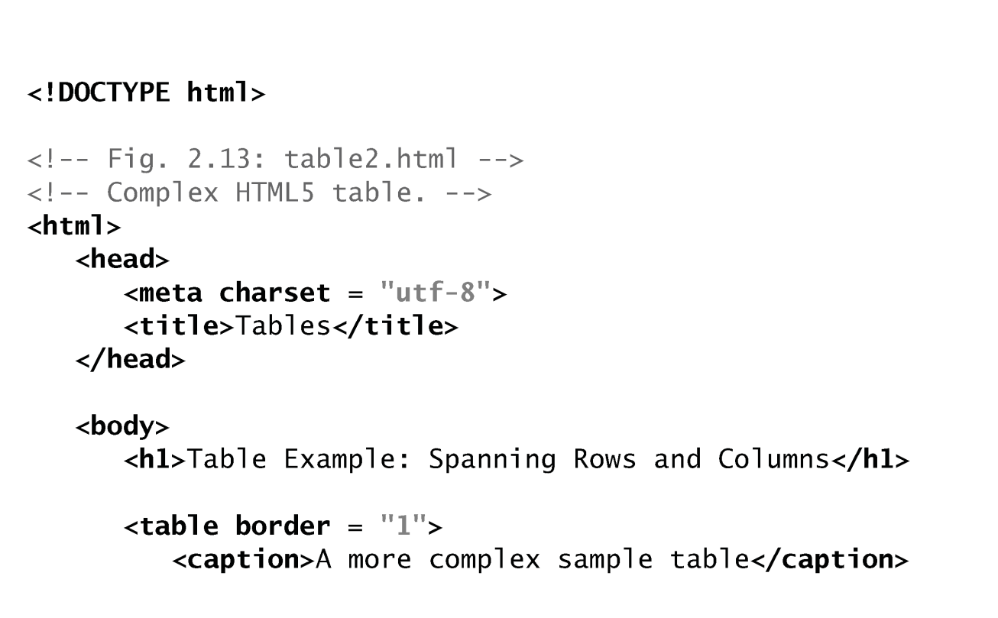
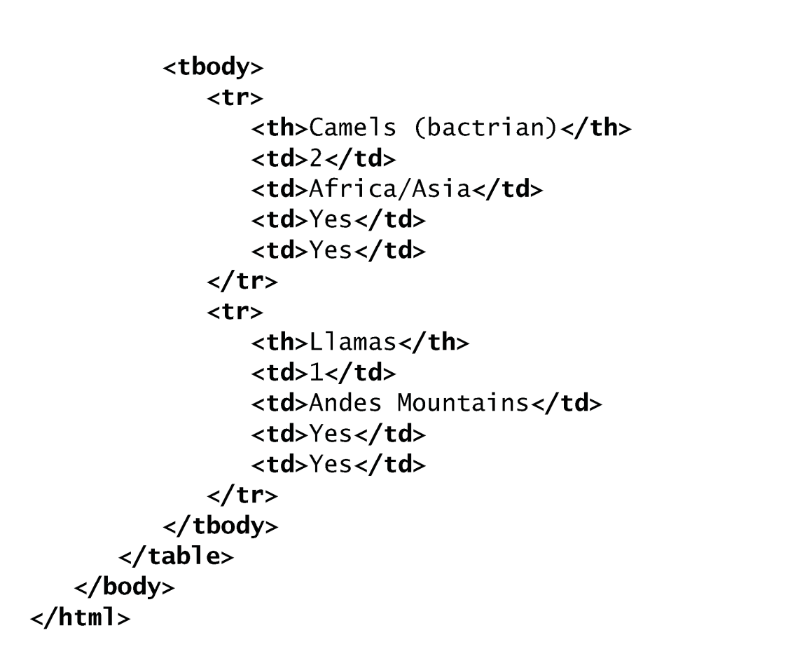
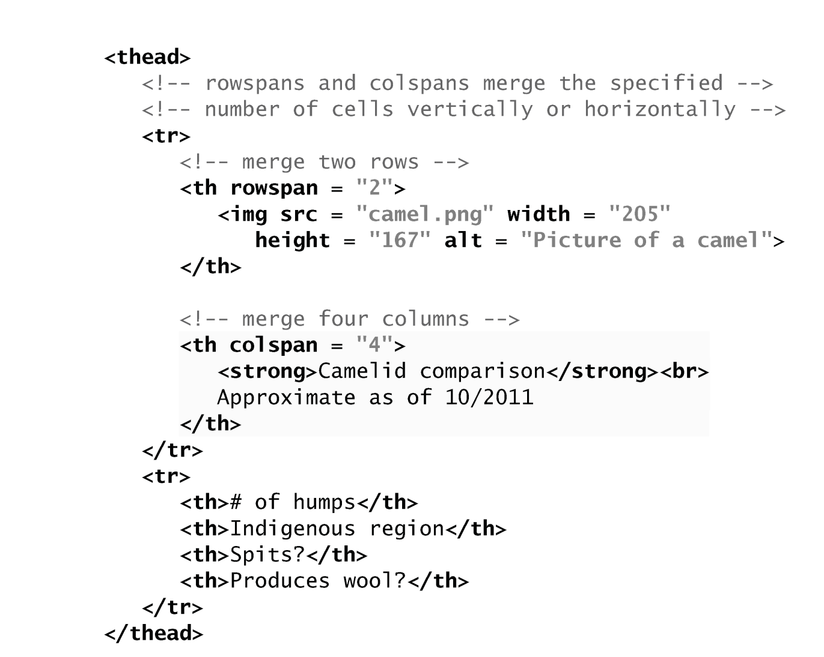
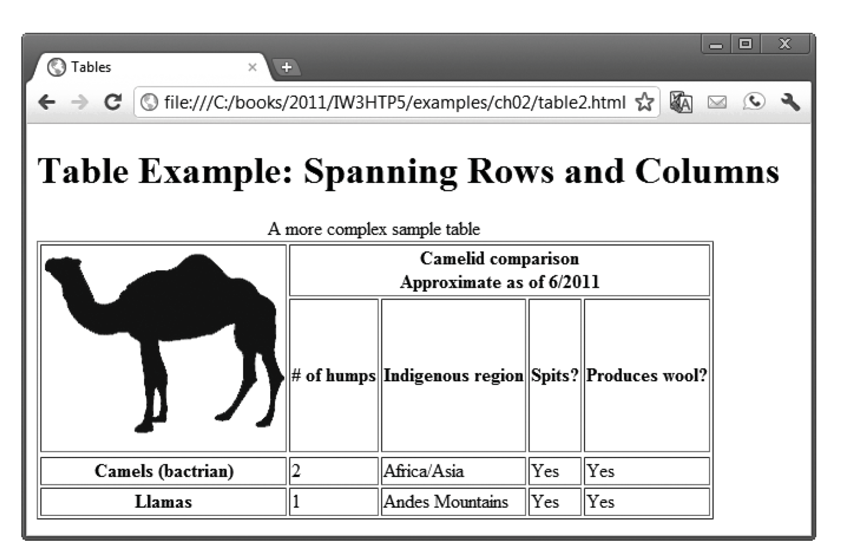
Can you predict what the browser how the browser will render this HTML?

Slide 14
Simple use of internal styles

Slide 15
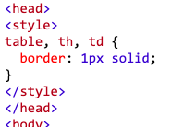
Cascading Style Sheets Styles
a way of formatting HTML elements by defining the appearance of the contents specified by element tags.
Up to now we’ve only shown you inline styles – where the style is defined as an attribute of the element.
  <table border="1">…
  More usefully, let’s start to use internal styles,
    Located in a style tag in the HTML’s head, thus internal to
    the web page, elements can be named and formatted.
    Allows the programmer to efficiently specify
    multiple elements with common/consistent formatting choices.

Slide 16
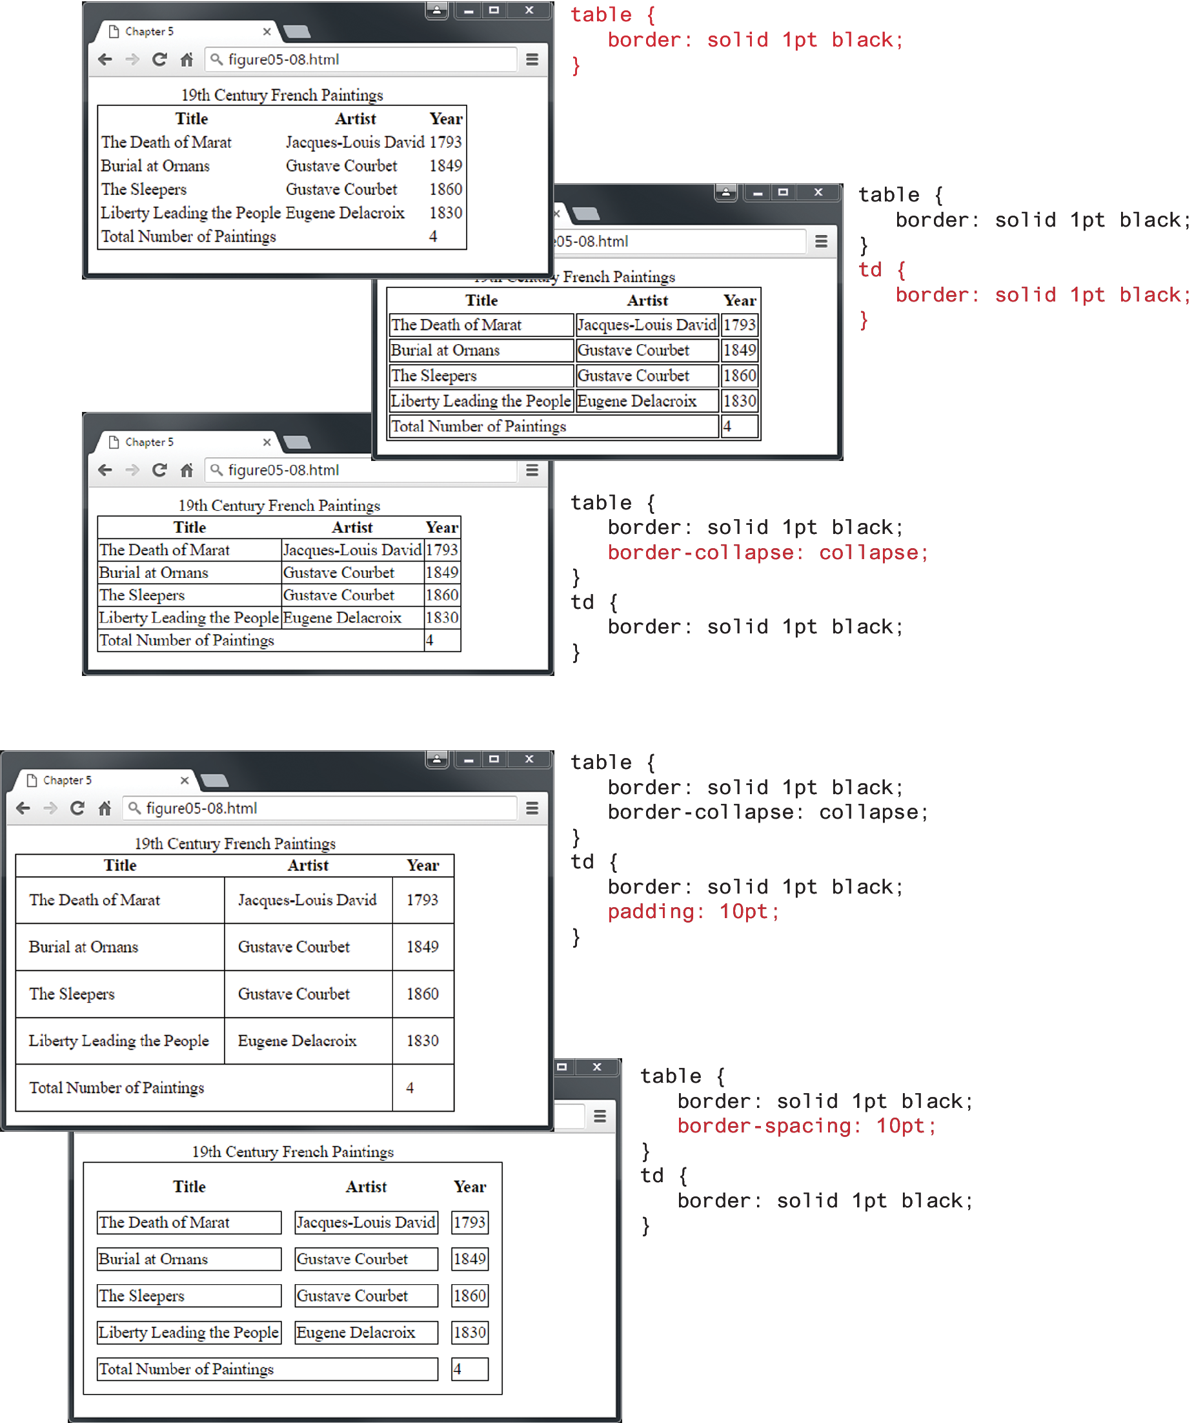
Styling table borders
Elements are named
Various attributes are specified within {}
each one ends with ;
Located within the <style> element in the <head>

Slide 17
Styling Tables (Borders)
Borders can be assigned to both the <table> and the <td> element.
  Borders cannot be assigned to the <tr>, <thead>, <tfoot>, and <tbody> elements.
Notice the border-collapse property. This property selects the table’s border model.
  The default is the separated model or value (each cell has its own unique borders)
  The collapsed border model makes adjacent cells share a single border.
Padding is can be assigned to both the <table> and the <td> element to put whitespace around the contents of a cell
Border-spacing puts whitespace around the cell itself.

Slide 18
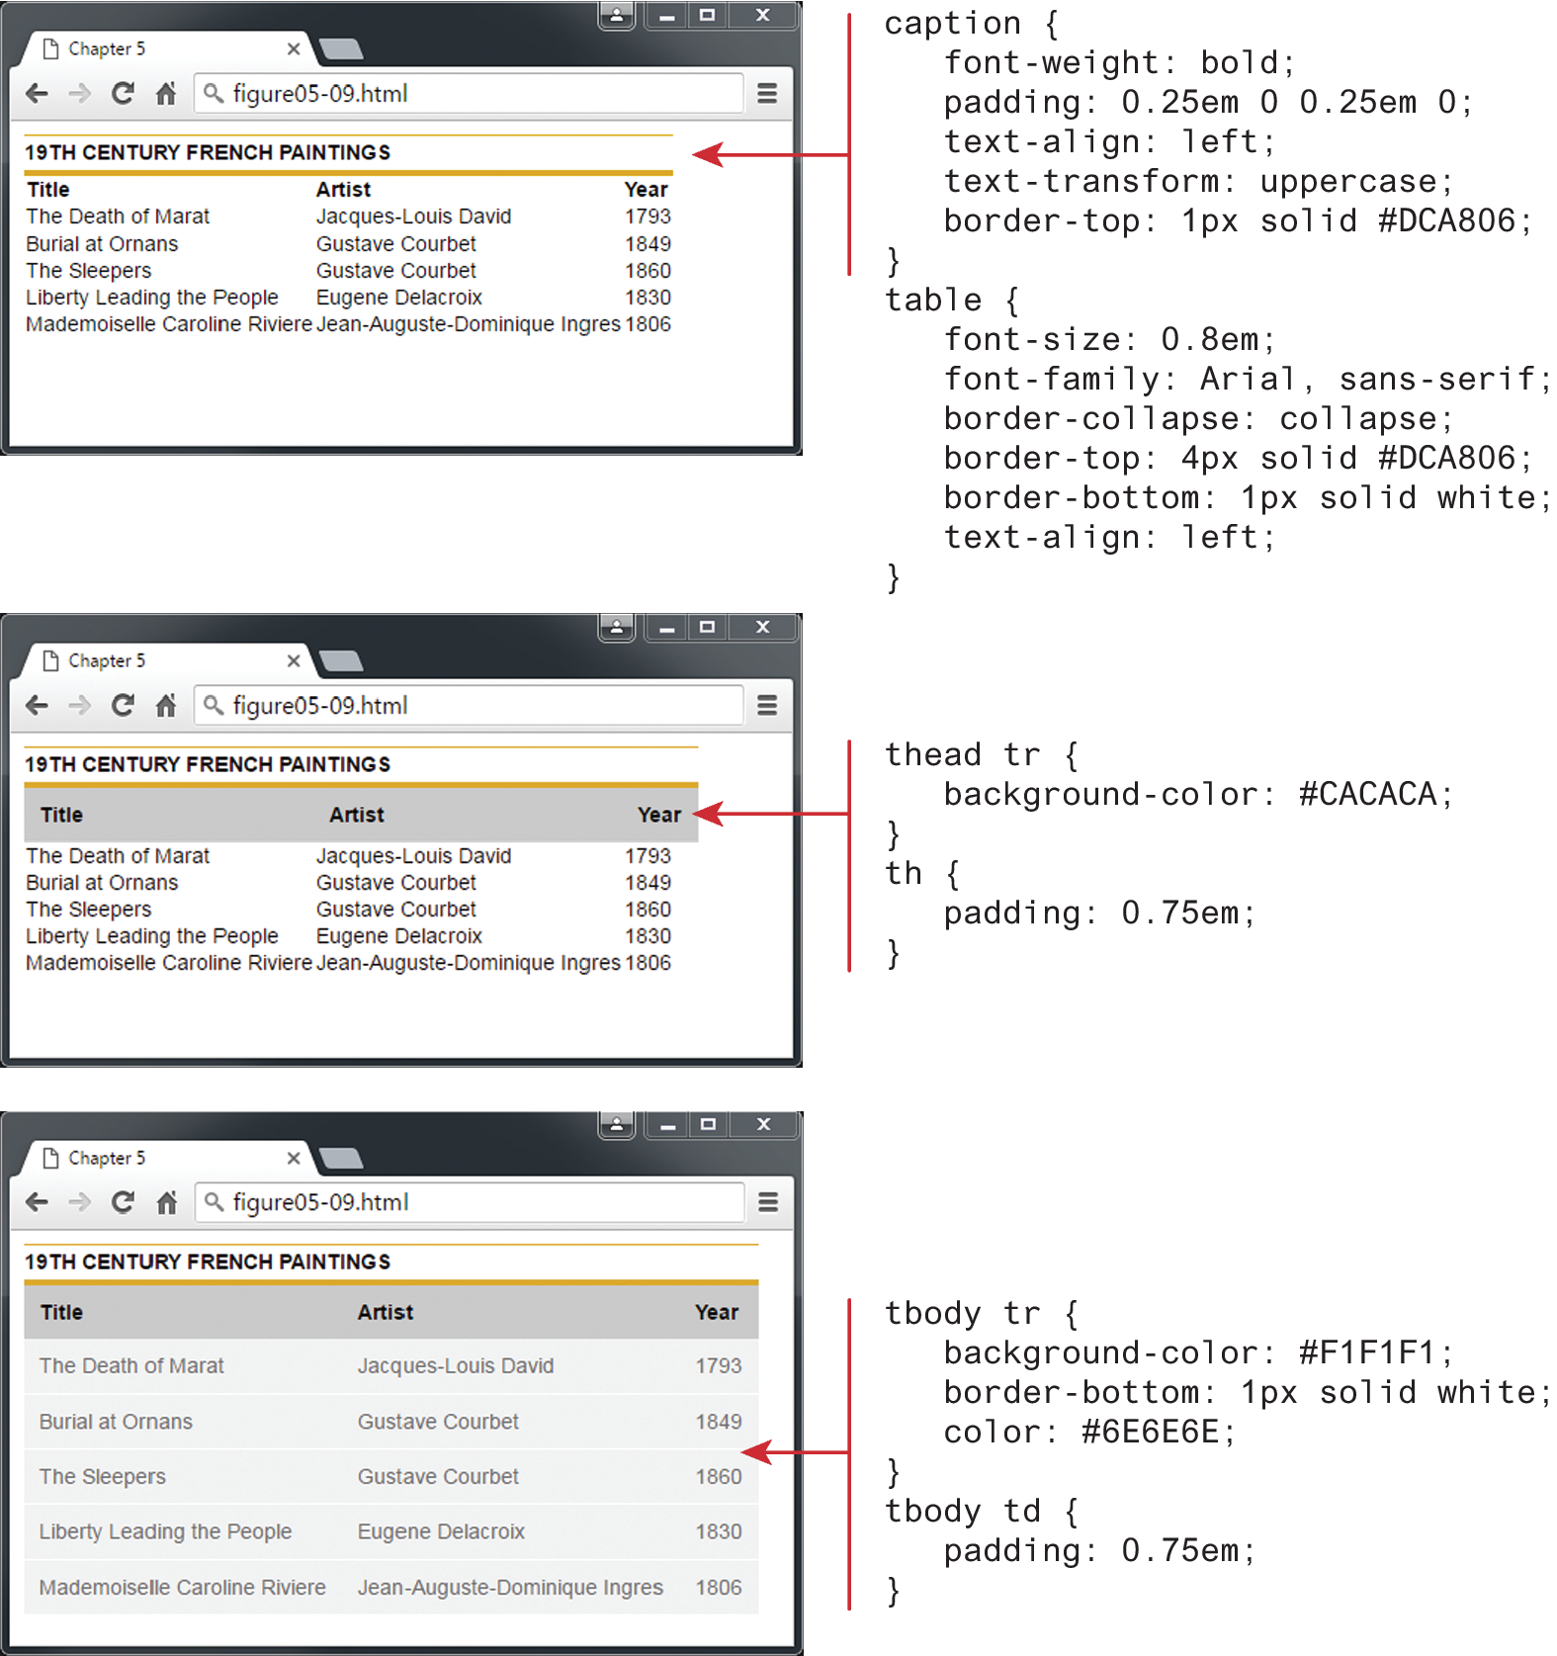
Box format with internal CSS
While there is almost no end to the different ways one can style a table, there are a number of common approaches.
A very common one: the box format,
  apply background colors and borders in various ways

Slide 19
Table with
Box Format

Slide 20
Any Question?

